Slide 1


FINAL GROUP PROJECT Live Weather Reports Data Programming
Shrushti Sanjay Sawant: 200525051
Sagarika Nagpal: 200533702
Sahil Duggal: 200505849

Slide 2
LAYOUT OF THE PRESENTATION
ABOUT THE DATA
SUMMARY OF THE PROJECT
DATA DESCRIPTION AND THE ATTRIBUTES OF THE DATA
TOOLS USED WITH TECHNOLOGY
FLOWCHART DESCRIPTION
DATA VISUALIZATION
REFERENCE

Slide 3



ABOUT US:
Shrushti Sanjay Sawant
Sagarika Nagpal
Sahil Duggal

Slide 4
SUMMARY OF PROJECT
Gathered Weather Data from an open-source API (https://openweathermap.org/) further connected it with the flask using python framework and using that to create powerful google chart visuals.
Access to weather products is made possible through quick, dependable APIs that adhere to industry standards and are compatible with various enterprise systems. Every one of our products includes crucial climate information for any region. Additionally, we have certain unique products that are beneficial for sectors of the economy that are impacted by weather, such as Road Risk API, Solar Radiation API, etc. Thus, in this project this API is being used.

Slide 5
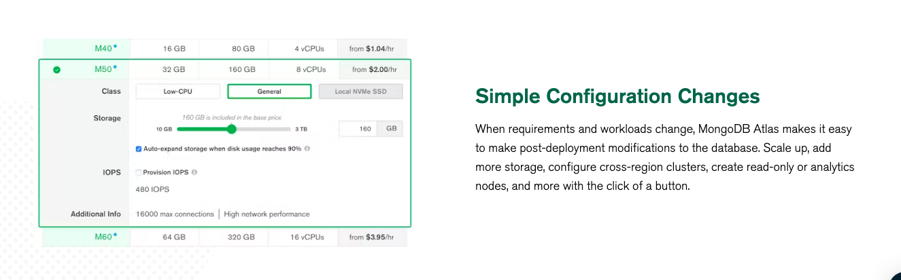
DESCRIPTION:
CREATING MONGO DB
CREATING ATLAS CLUSTER

Slide 6
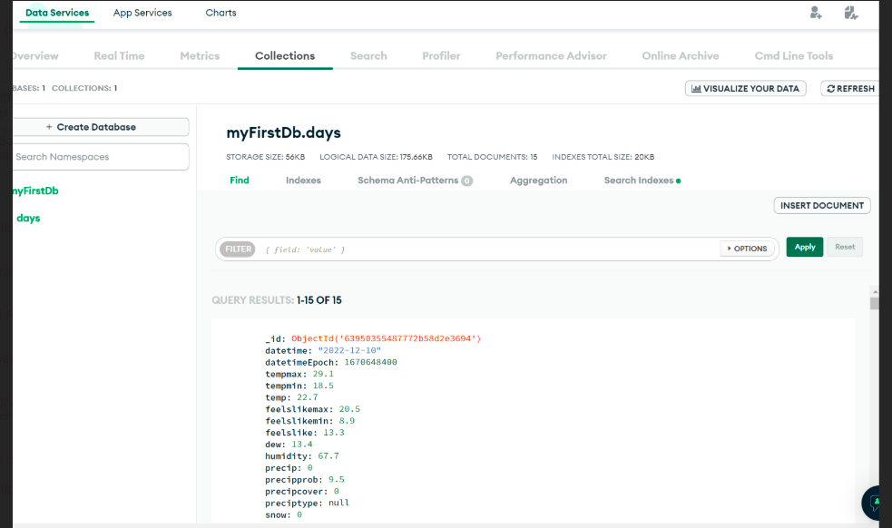
DATA DESCRIPTION
Data comes rom different location where the data description defined the size of Document and also the storage size.

Slide 7
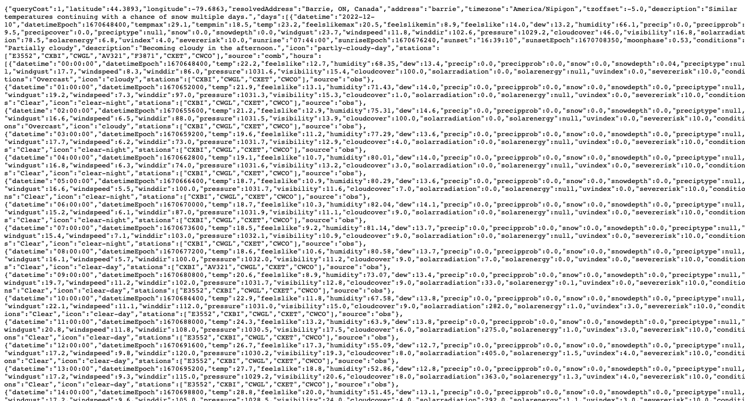
ATTRIBUTES OF DATASET
The data was retrieved in JSON format from the API and stored into Mongo DB.
Dataset has columns as:
datetime,datetimeEpoch,tempmax,tempmin,temp,feelslikemax,feelslikemin,feelslike,dew,humidity,precip,precipprob,precipcover,snow,snowdepth,windgust,windspeed,winddir,pressure,cloudcover,visibility,solarradiation,solarenergy,uvindex,severerisk,sunrise,sunriseEpoch,sunset,sunsetEpoch,moonphase,conditions,description,icon,source

Slide 8





TECHNOLOGIES AND TOOLS THAT ARE USED:

Slide 9
Get the Data from API in JSON format
Fetch the data in Weather API
Load data into Python (FLASK) using API request
Connect Python Prog with the database and store that data into Mongo DB
Visualize the data using Google charts.

Slide 10

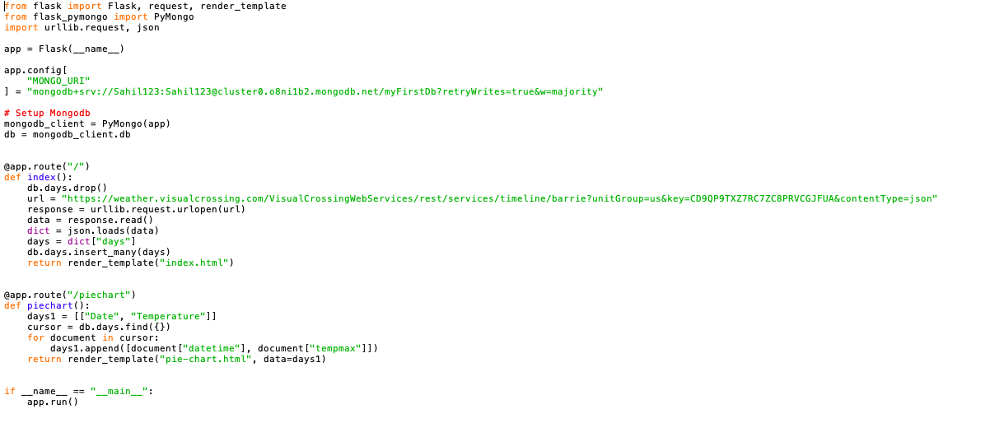
PROJECT CODE

Slide 11


DATA VISUALIZATION

Slide 12
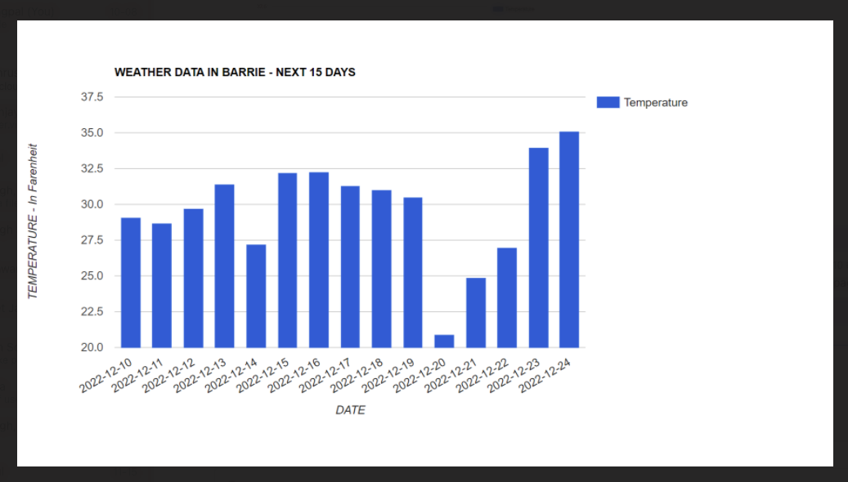

Slide 13


Fit – Gap Analysis
GAP Identification | YES | NO |  |  |  |  |  |  | PRIORITY STATUS | HIGH | MEDIUM | LOW
OBJECTIVE | CURRENT STATE | DESIRED STATE | GAP IDENTIFIED | DESCRIPTION | CORRECTIVE ACTION | PRIORITY
Use Flask as framework |  | We are at the desired state | NO |  |  | HIGH
Pull data from an API |  | We are at the desired state | NO |  |  | HIGH
Store the data into clud based database |  | We are at the desired state | NO |  |  | HIGH
Visualize using google charts |  | We are at the desired state | NO |  |  | HIGH
Run a pseudo batch |  | We want to be able to update the database every 24 hour | YES | Not able to run a pseudo batch as the app is not deployed on cloud |  | HIGH
Deploy the app on cloud |  | We want to be able to deploy the app on cloud | YES | The app isn't deployed as Heroku is now paid | Try to deploy on python anywhere | HIGH

Slide 14
REFERENCES
OpenWeather API: https://home.openweathermap.org/
Class Notes
Flask Documentation: https://flask.palletsprojects.com/en/2.2.x/

Slide 15

THANK YOU

